Slide 1
Diabetes Detection System Using Machine Learning
BSc Computing (Software Engineering)
Submitted By: XXXXX-YYYY
Submitted To: XXXX.YYYUU

Slide 2

INTRODUCTION:
Introducing the Diabetes Detection System Using Machine Learning, a cutting-edge solution for accurate diabetes detection and type identification.
The system leverages machine learning algorithms and data analysis techniques to analyze user inputs and determine the presence of diabetes.
By considering factors such as age, hypertension, heart disease, BMI, HbA1c level, and blood glucose level, the system identifies specific diabetes types.
Users can access the system through a user-friendly web page developed with Flask, featuring registration, login, and authentication functionalities.

Slide 3
Cont..
Personal data and testing history are securely stored in a database, enabling users to review their health information and progress.
The system provides tailored instructions, food recommendations, medication details, and access to a list of doctors and hospitals for each diabetes type.
Sample data is available for users to test the system's features, ensuring a seamless and reliable user experience.
An admin portal is implemented for efficient management of user data, instructions, food recommendations, medications, and doctor information.
The Diabetes Detection System aims to revolutionize diabetes management, improving early detection, personalized treatment, and patient empowerment.

Slide 4
Aims and Objectives
Our system has the following aims and objectives:
Accurately detect whether a person has diabetes or not.
Identify the type of diabetes the person is suffering from, such as Gestational Diabetes, etc.
Provide a user-friendly web page for individuals to register, log in, and access the system's features.
Implement authentication and restrictions to ensure data privacy.

Slide 5
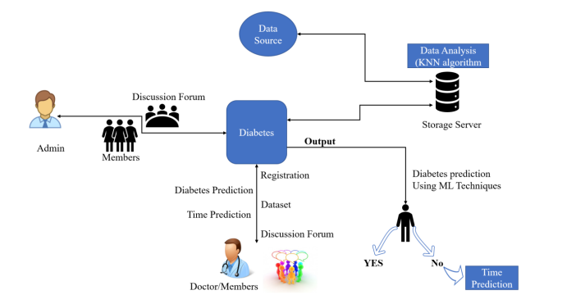
Architecture Design

Slide 6

Methodology
The Diabetes Detection System utilizes a combination of machine learning algorithms and data analysis techniques.
Classification algorithms, such as Decision Trees, Random Forests, or Support Vector Machines, are employed to determine the type of diabetes based on user input.
The machine learning model is trained using a carefully curated dataset containing labeled examples of different diabetes types.
Feature selection techniques are utilized to identify the most relevant factors contributing to diabetes detection and type identification

Slide 7
Literature Review
Extensive research has been conducted on diabetes detection using machine learning.
Previous studies have focused on feature selection, classification algorithms, and accuracy improvements.
Our system builds upon this existing research, aiming to address limitations and enhance detection accuracy.

Slide 8

System Analysis and Design
For the web page design, we will utilize the Flask web framework, a powerful and flexible tool for developing web applications in Python.
Flask provides a robust foundation for creating user-friendly and interactive web interfaces.
The web page design will focus on intuitive navigation, responsive layouts, and visually appealing aesthetics to enhance the overall user experience.
Attention will be given to accessibility, ensuring that the web page will be easily accessible and usable by individuals with diverse abilities.

Slide 9
Admin Portal
The admin portal enables authorized individuals to log in and manage user data securely.
Admins have the authority to handle user registration, access user details, and maintain data accuracy.
Additionally, admins can manage instructions, food recommendations, medication information, and doctor details.

Slide 10
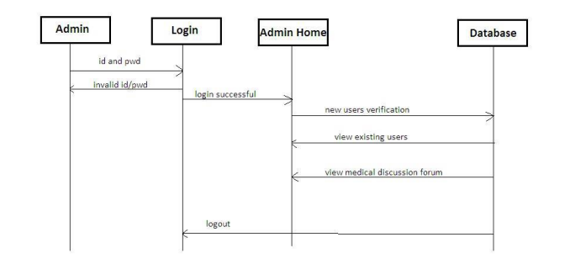
SEQUENCE DIGRAM
Sequence diagram of Admin module

Slide 11
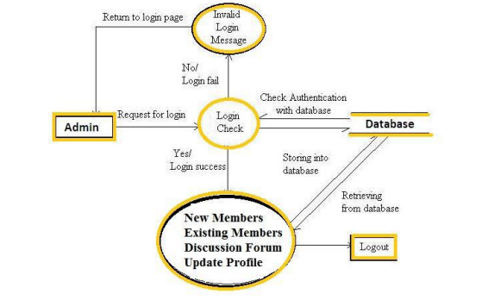
Data flow for Admin

Slide 12
User Data and History
User data is securely stored in a database, ensuring privacy and compliance with data protection regulations.
Users can access a separate page to view their personal details and testing history, enabling them to monitor their health effectively.

Slide 13


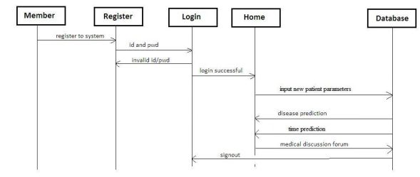
SEQUENCE DIGRAM
Sequence diagram of User module

Slide 14
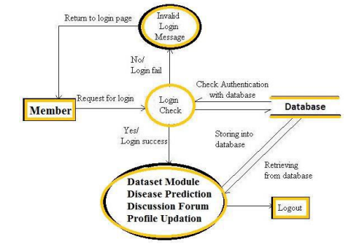
Data flow for User

Slide 15
Testing
Rigorous testing procedures were conducted to evaluate the performance of the Diabetes Detection System.
Two machine learning algorithms, Support Vector Machine (SVM) and Decision Tree, were employed for diabetes detection and type identification.
SVM algorithm achieved an accuracy of 92.5% in correctly identifying the diabetes types.
Decision Tree algorithm exhibited exceptional accuracy, achieving a remarkable 99% in accurately classifying the diabetes types.
The testing process involved utilizing a carefully curated dataset with labeled examples of different diabetes types.
Various performance metrics, such as accuracy, precision, recall, and F1-score, were calculated to assess the system's performance.

Slide 16
Progress
We have made significant progress in the development of the Diabetes Detection System.
The system architecture has been implemented, including user registration, login, and data submission functionalities.
Machine learning algorithms, specifically Support Vector Machine (SVM) and Decision Tree, have been trained and integrated into the system.
Rigorous testing has been conducted, achieving a high accuracy rate of 92.5% with SVM and an exceptional accuracy of 99% with Decision Tree for diabetes detection and type identification.
The system architecture, including data preprocessing, feature selection, and model integration, has been successfully implemented.
The database structure for user data storage has been designed and implemented, ensuring secure and efficient management of user information.

Slide 17
Future Plans
Our future plans entail several significant enhancements and developments for the Diabetes Detection System.
The immediate focus is on designing and implementing the user interface, which will be developed using Flask, a Python web framework known for its flexibility and scalability.
The user interface will be intuitive, providing users with a seamless experience in registering, logging in, and submitting their diabetes-related data.
We aim to expand the system's capabilities by incorporating additional diabetes types, enabling a more comprehensive diagnosis.
Personalized recommendations, including instructions, food recommendations, medication details, and treatment options, will be integrated into the system based on the user's specific diabetes type.
Continuous testing and refinement of the machine learning models will be conducted to improve accuracy and robustness.
Collaboration with healthcare professionals, research institutions, and medical experts will be sought to ensure the system remains up to date with the latest advancements in diabetes diagnosis and treatment.

Slide 18
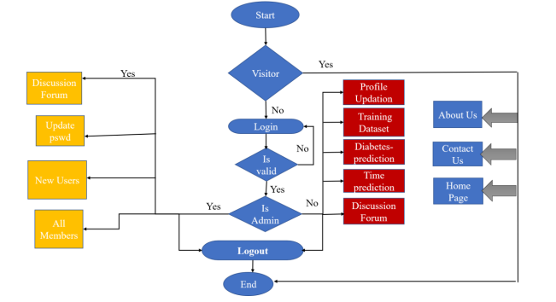
Control Flow

Slide 19
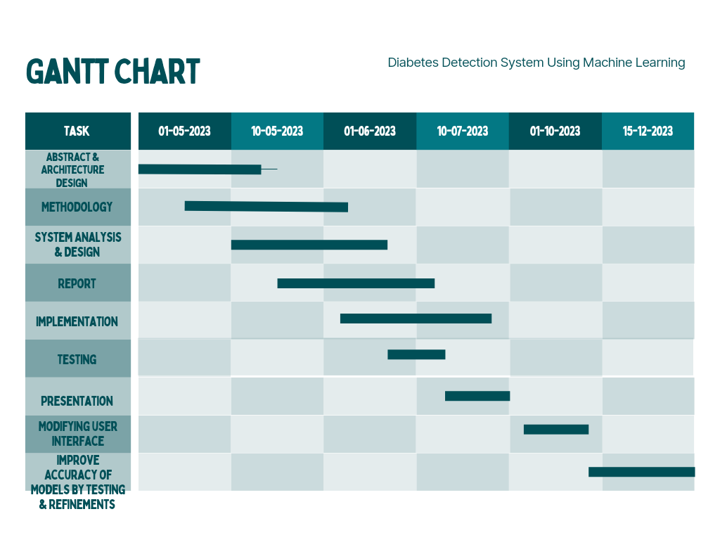

Slide 20
Conclusion
The Diabetes Detection System represents a significant advancement in diabetes diagnosis and personalized treatment.
By leveraging machine learning, our system achieves accurate detection and identification of different diabetes types.
We believe this system has the potential to positively impact diabetes management and improve patient outcomes.

Slide 21
THANK YOU!!!

